Slide 1
Trees
Computer Science, Purdue University
Copyright WILEY, Goodrich and Tamassia, Data Structures And Algorithms

Slide 2
Trees
Introduction
Trees
Binary trees
Traversals of trees
Data structures for trees
Computer Science, Purdue University

Slide 3
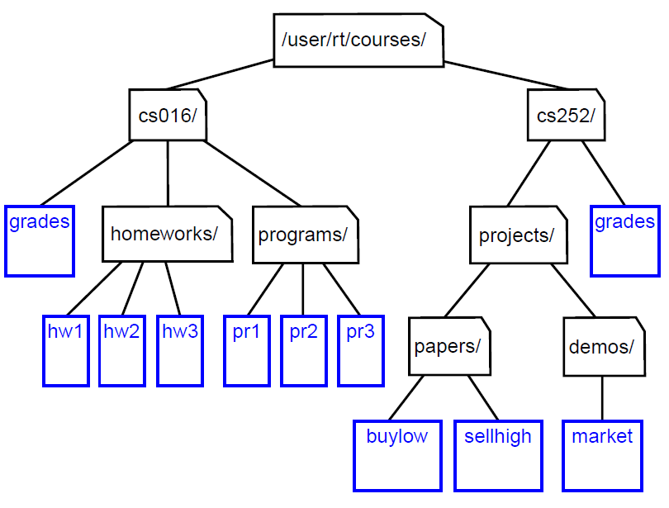
Trees
Example
Computer Science, Purdue University

Slide 4
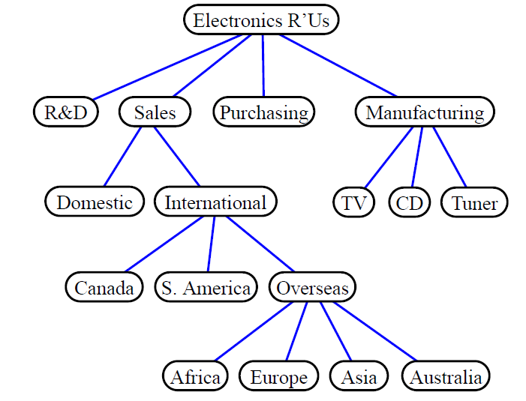
Trees
Example
Computer Science, Purdue University

Slide 5
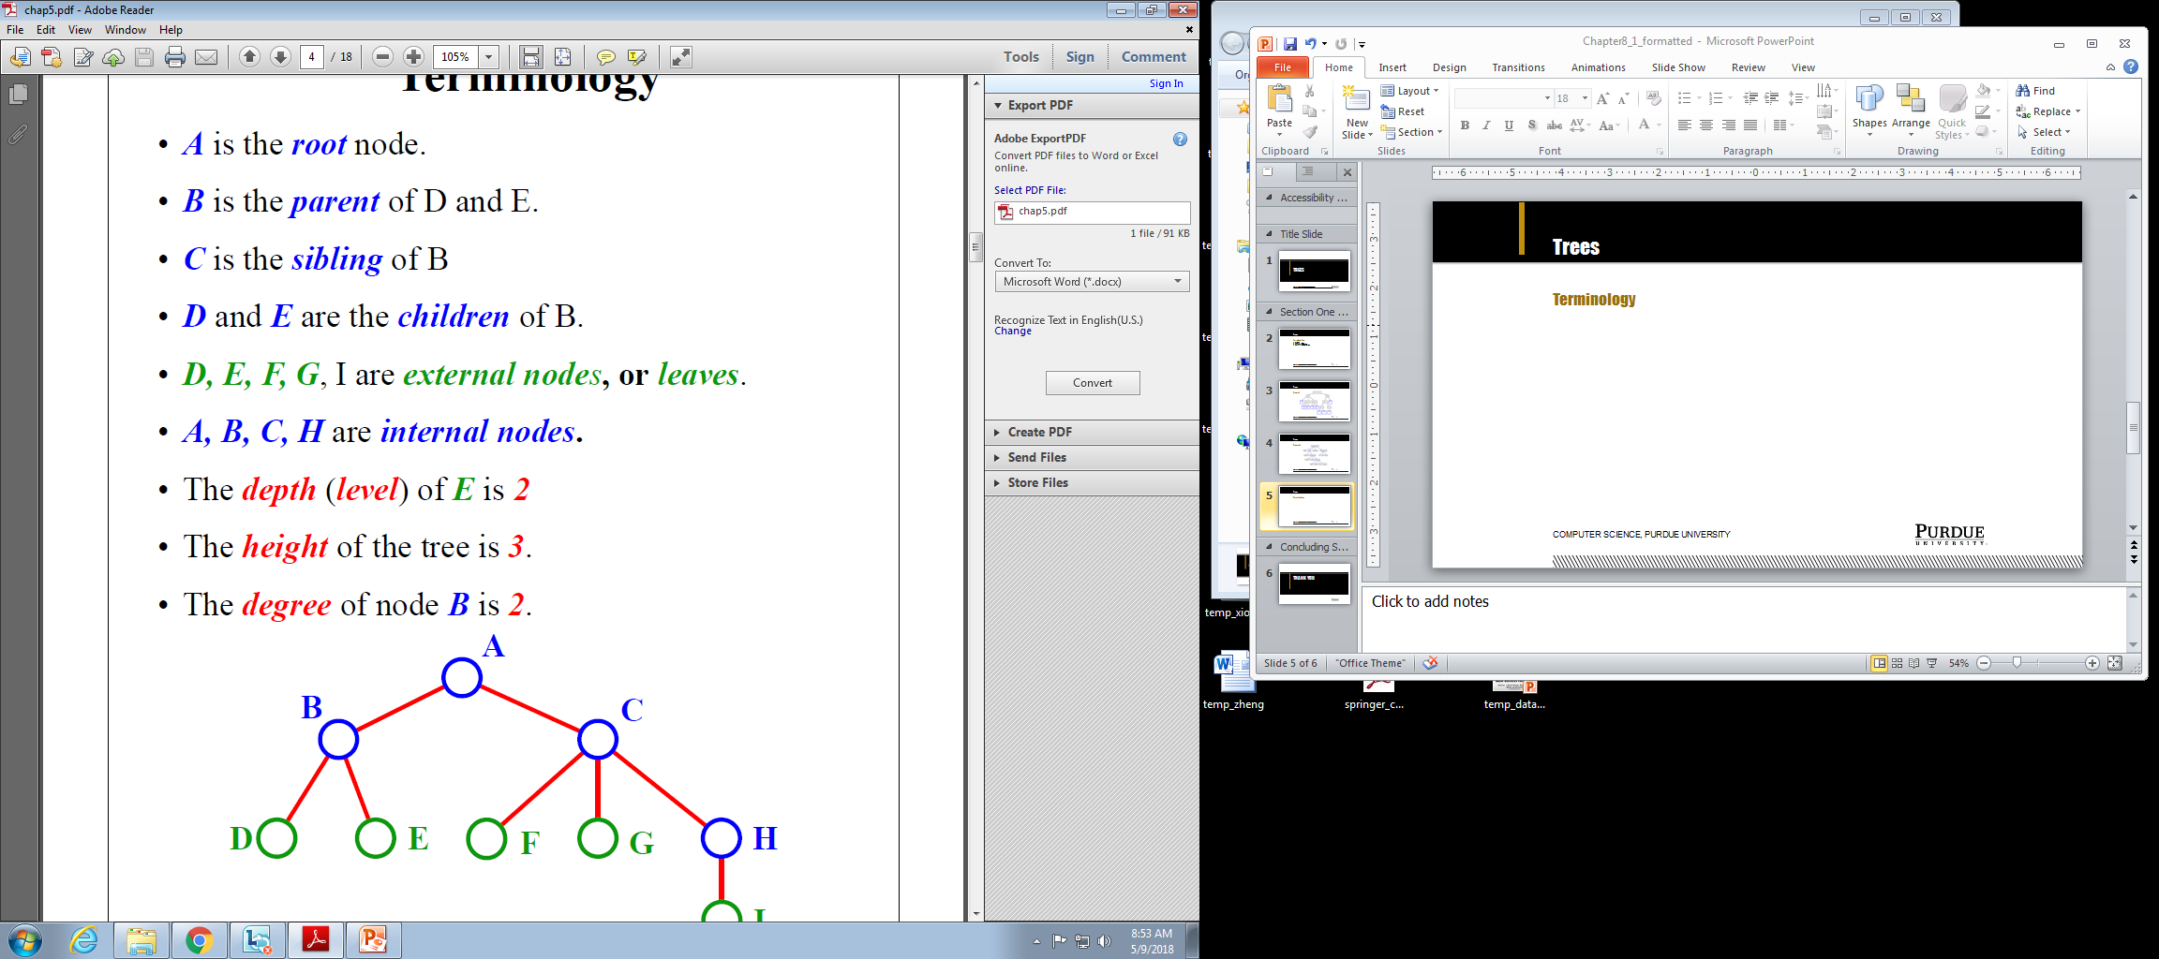
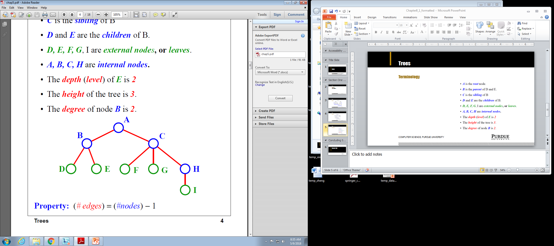
Trees
Terminology
Computer Science, Purdue University

Slide 6
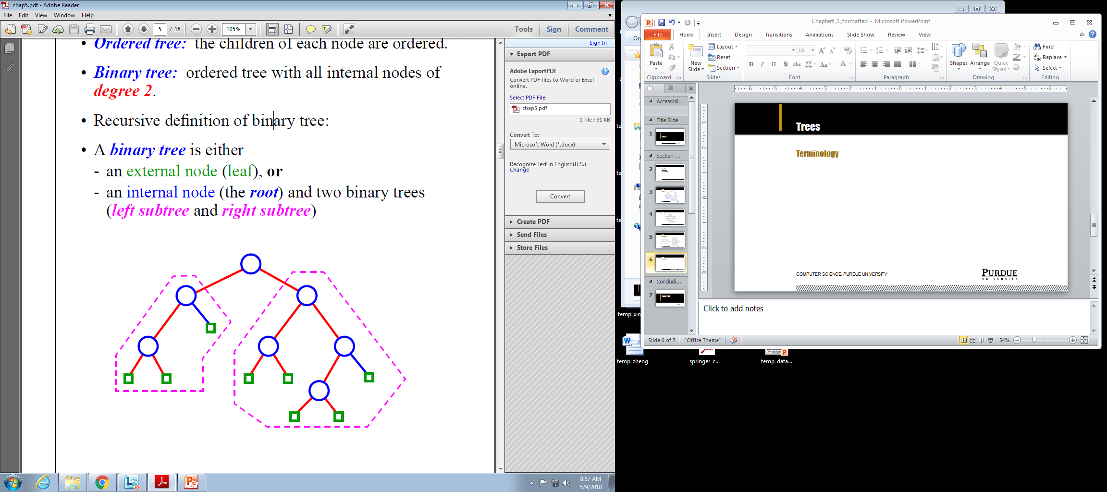
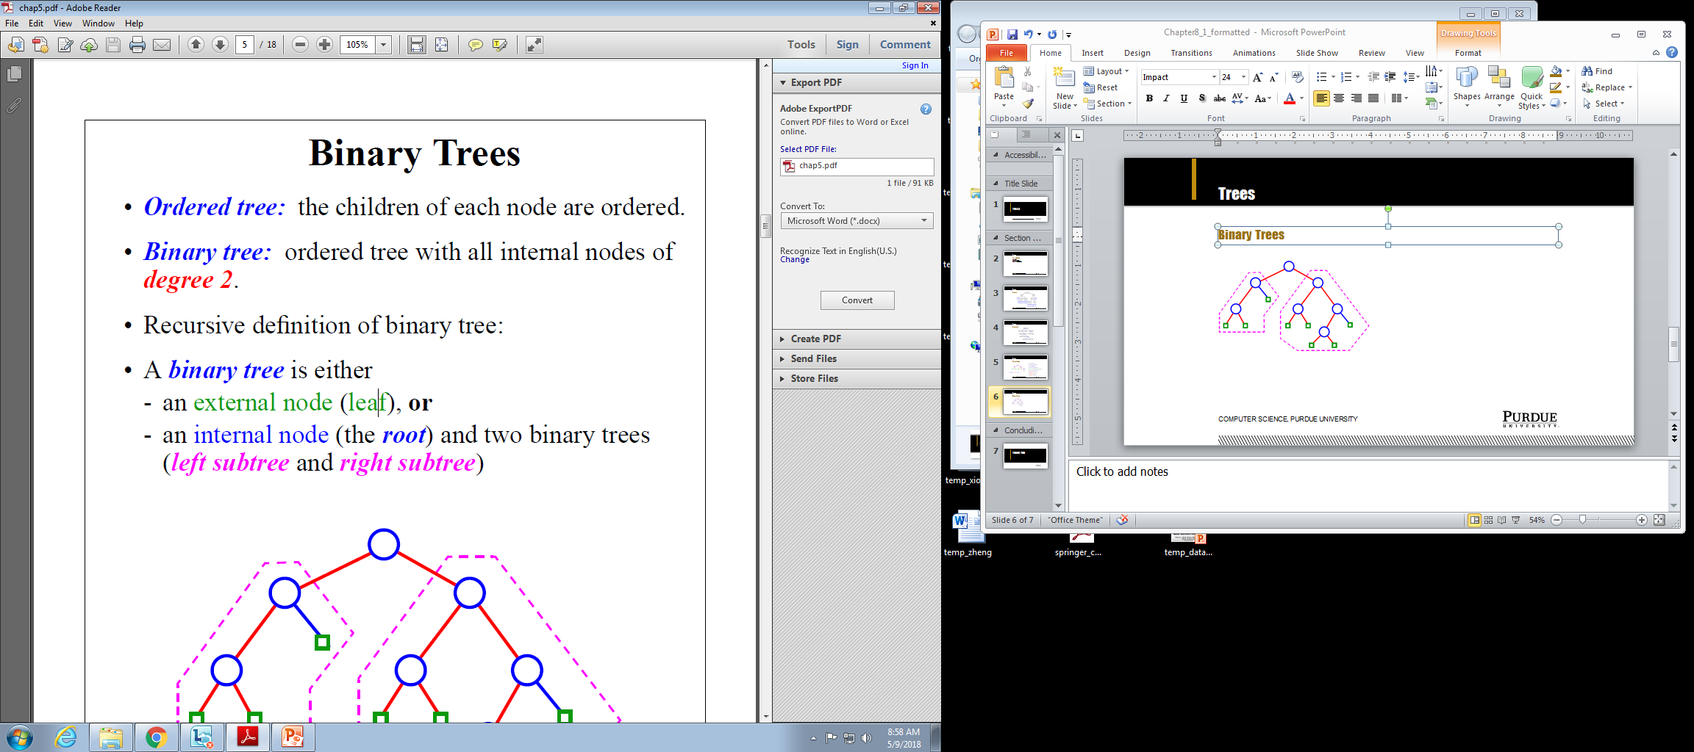
Trees
Binary Trees
Computer Science, Purdue University

Slide 7
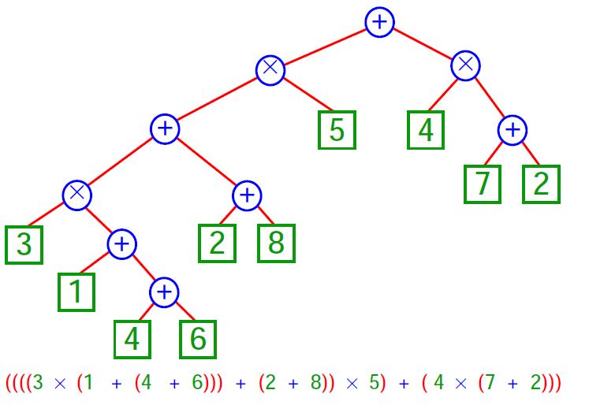
Trees
Binary Trees: Example
Computer Science, Purdue University

Slide 8
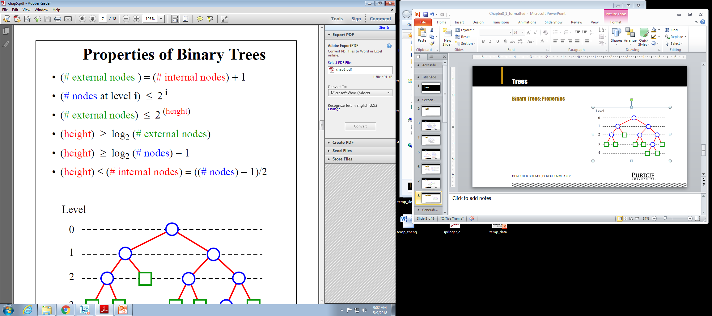
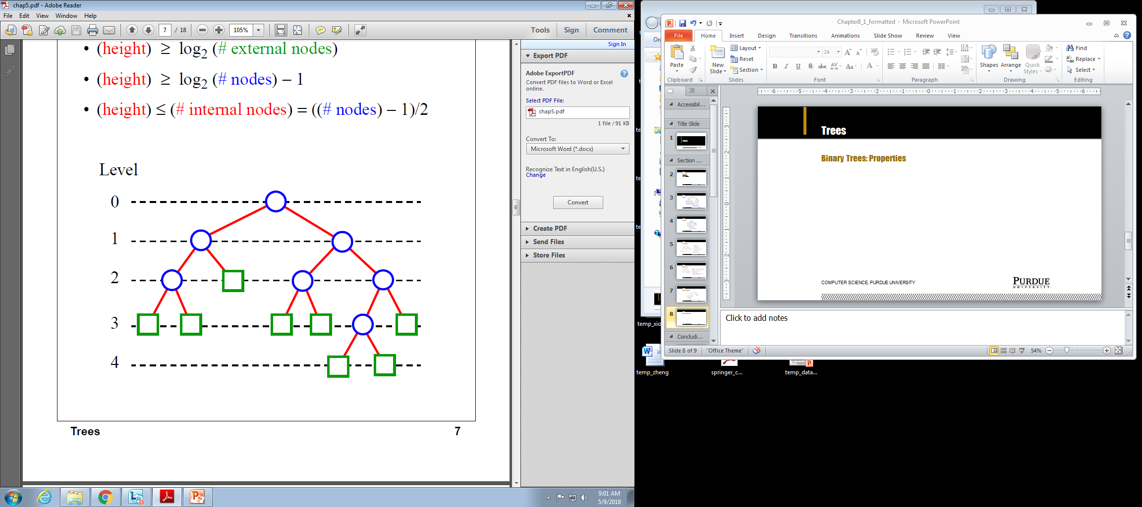
Trees
Binary Trees: Properties
Computer Science, Purdue University

Slide 9
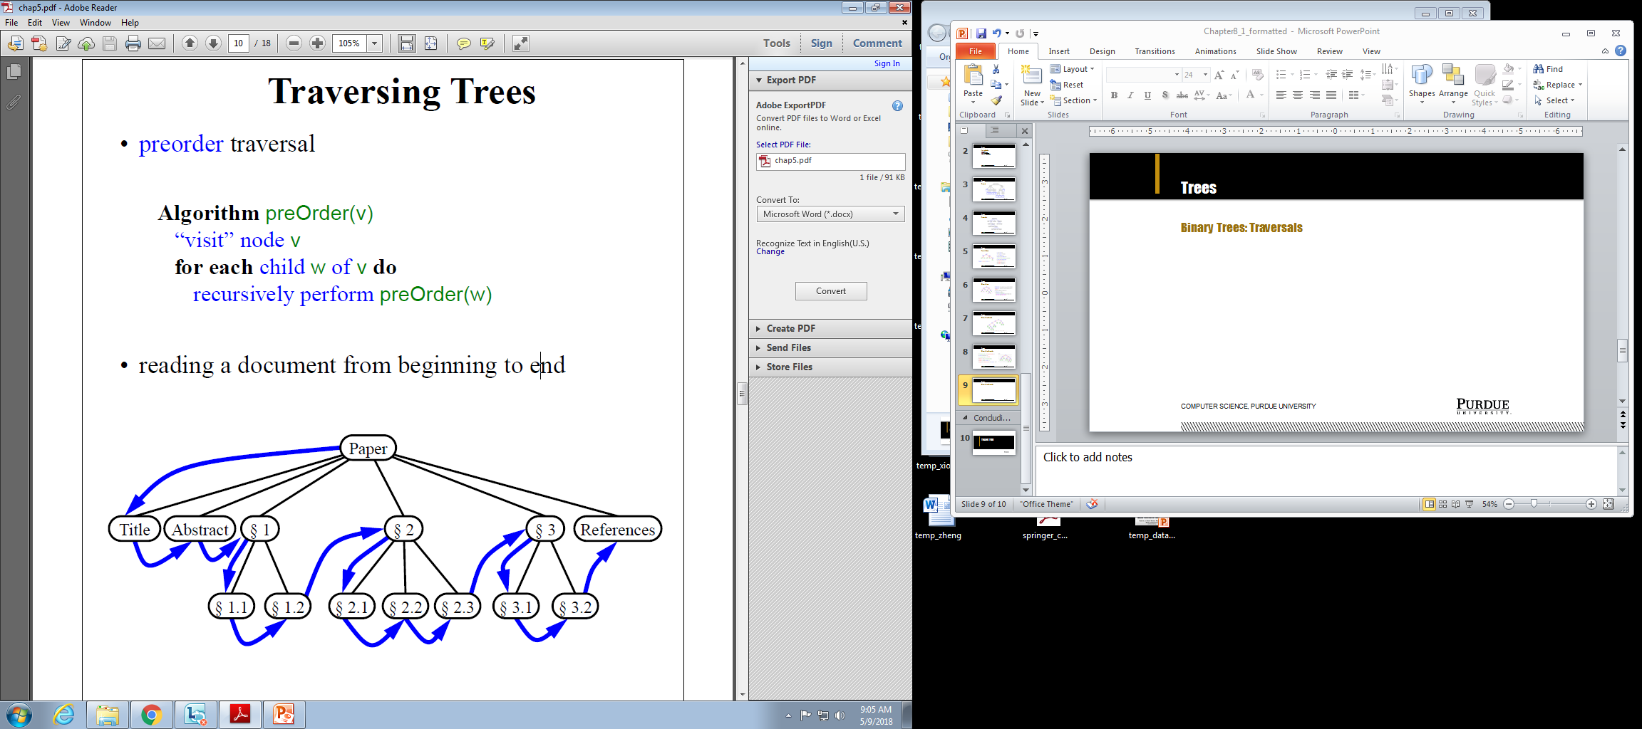
Trees
Binary Trees: Traversals
Computer Science, Purdue University

Slide 10
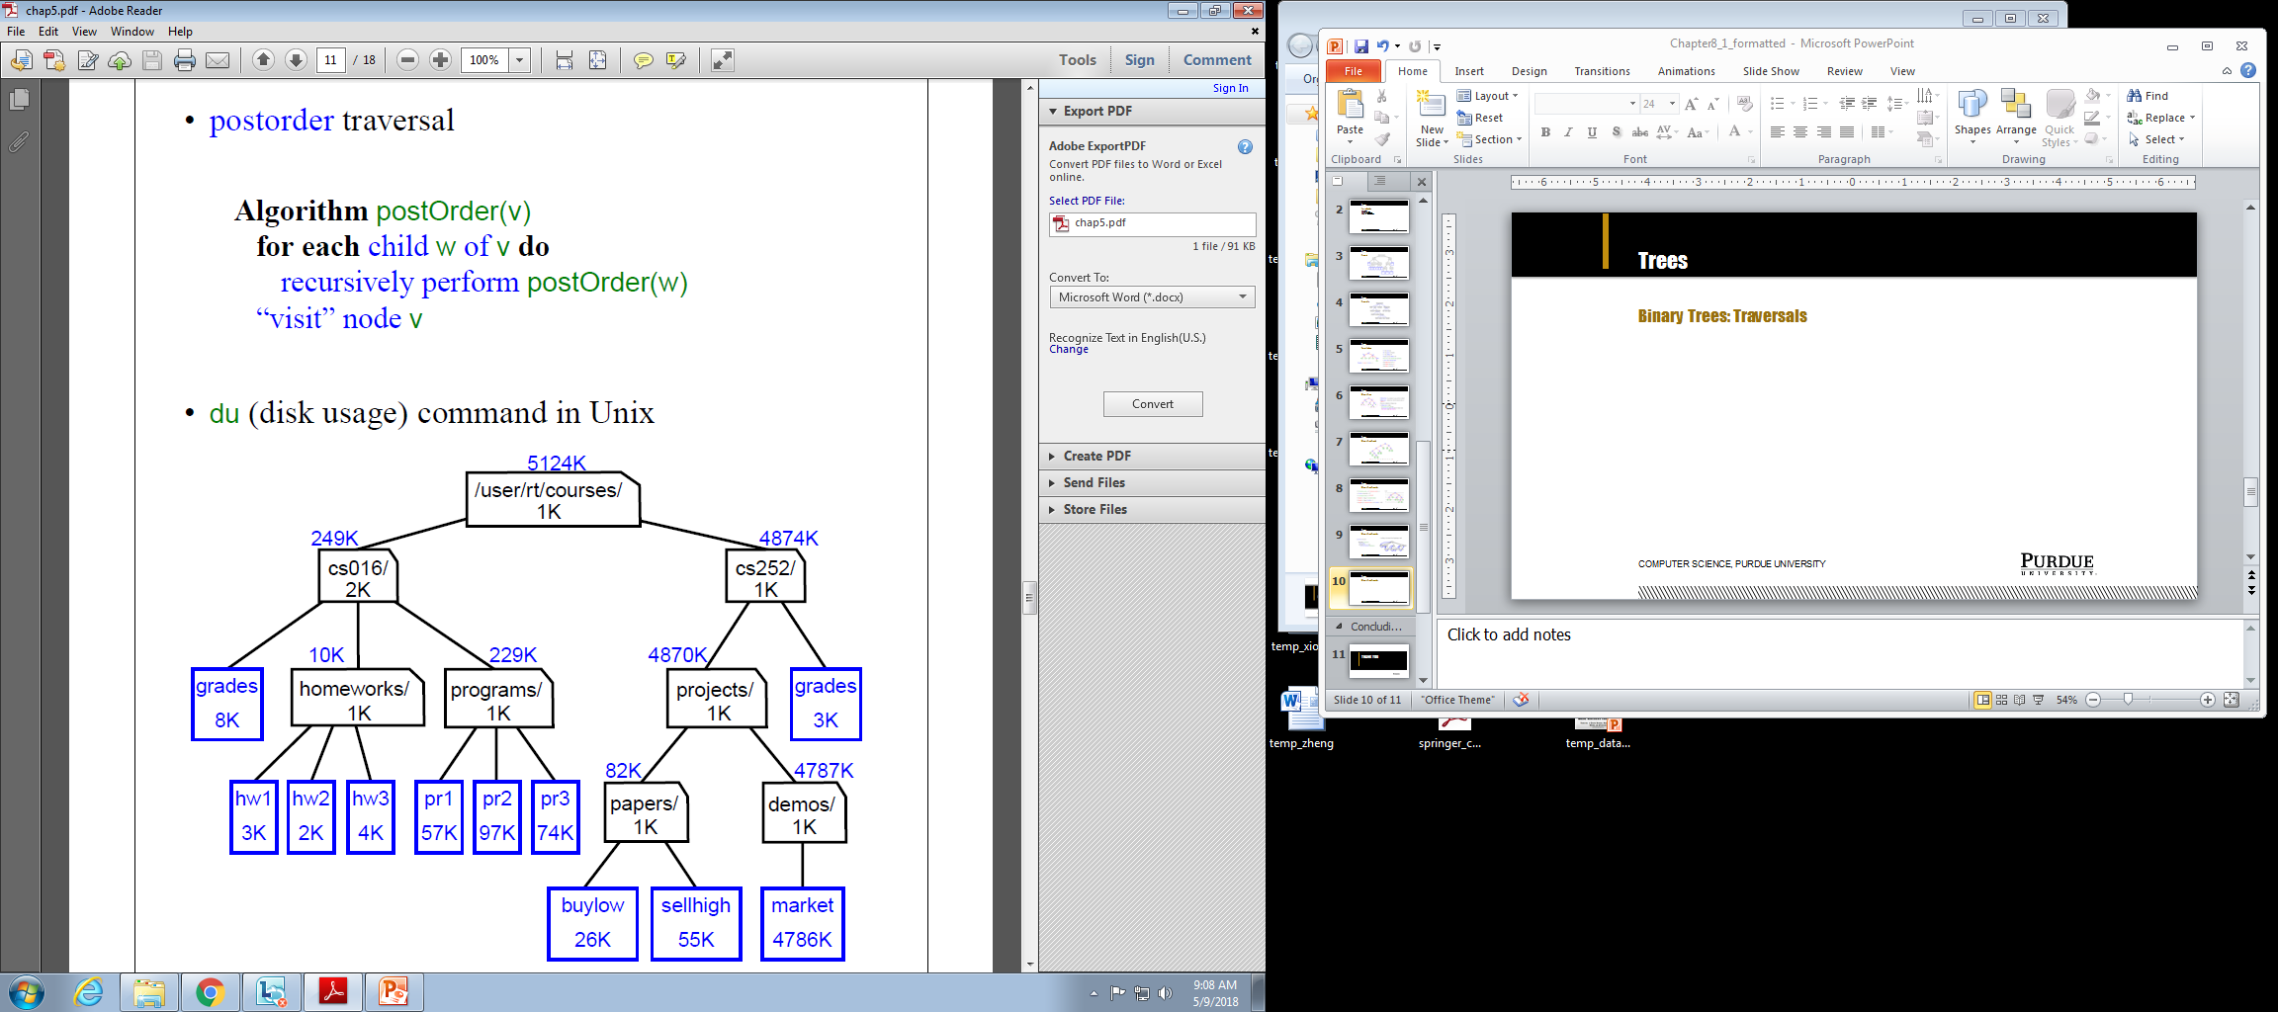
Trees
Binary Trees: Traversals
Computer Science, Purdue University

Slide 11
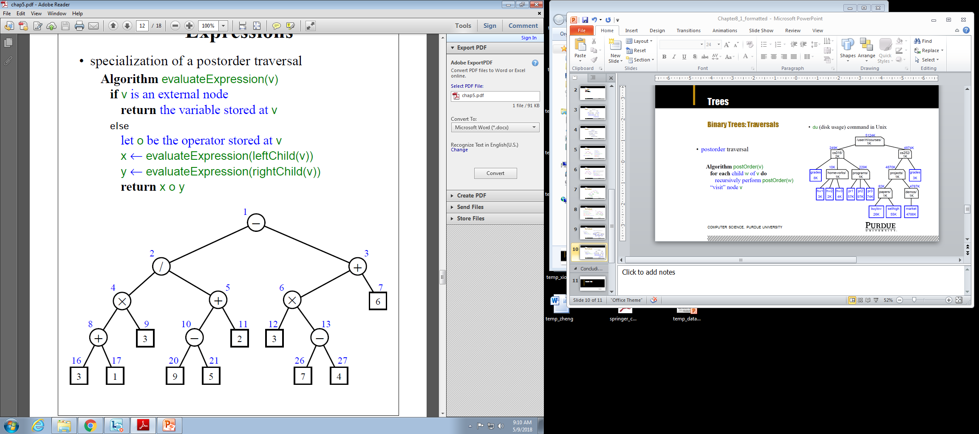
Trees
Binary Trees: Traversals
Computer Science, Purdue University

Slide 12
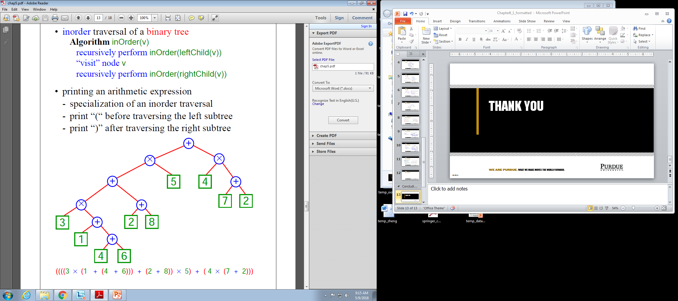
Trees
Binary Trees: Traversals
Computer Science, Purdue University

Slide 13
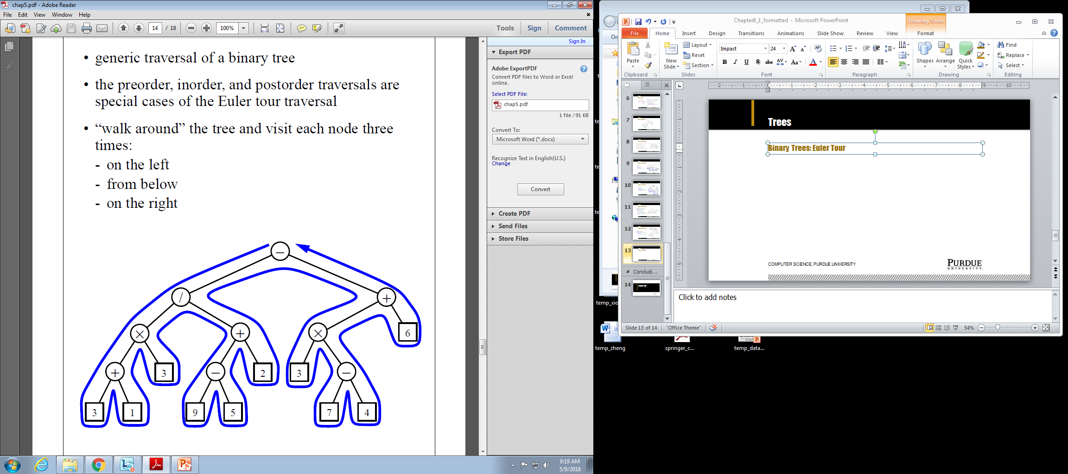
Trees
Binary Trees: Euler Tour
Computer Science, Purdue University

Slide 14
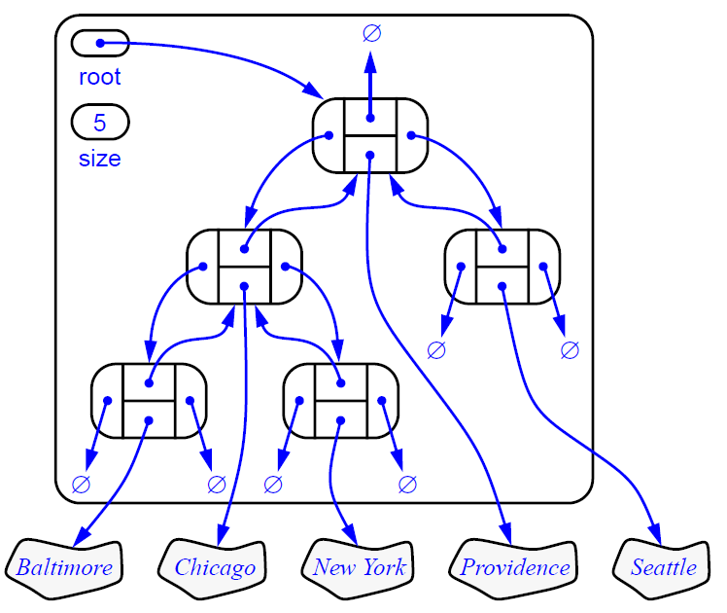
Trees
Binary Trees:
Representation
Computer Science, Purdue University

Slide 15
Thank You

